Slide 1

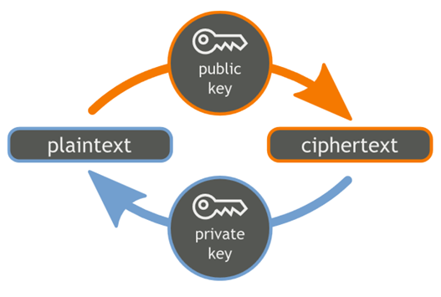

RSA Encrypt and Decrypt in Python
RSA
RSA Key Generation, Encrypt and Decrypt

Slide 2
The RSA Cipher in Practice
The RSA cryptosystem uses public / private key pair
Public key: modulus n (big integer) + exponent e (usually 65537)
Private key: secret exponent d (big integer)
Key length: 1024 (weak), 2048, 4096, …, 16384 or more bits
RSA can encrypt data of size limited by the key length
Usually, encrypt a symmetric key (AES) → protect data of any size
PKCS#1 (RFC 8017) defines the recommendations for:
Public-key cryptography based on the RSA algorithm
Optimal Asymmetric Encryption Padding (OAEP)

Slide 3
Example: RSA Encrypt / Decrypt in Python
from Crypto.PublicKey import RSA
from Crypto.Cipher import PKCS1_OAEP
import binascii
keyPair = RSA.generate(2048)
pubKey = keyPair.publickey()
print(f"Public key: (mod={pubKey.n}, exp={pubKey.e})")
print("Private key:", keyPair.d)
encryptor = PKCS1_OAEP.new(pubKey)
encrypted = encryptor.encrypt(b'Some message')
print("Encrypted:", binascii.hexlify(encrypted))
decryptor = PKCS1_OAEP.new(keyPair)
decrypted = decryptor.decrypt(encrypted)
print('Decrypted:', decrypted)
pip install pycryptodome

Slide 4

RSA Encrypt and Decrypt in Python
Try the Code!

